Slide 1

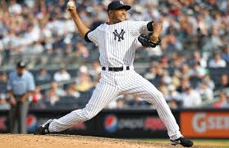
Tufts BAT: Reliever Performance
Max Druckman, Ben Goldberg, Ronan Hwang, Daniel Jakab, Ben Mascuch

Slide 2

Table of Contents
Table of Contents
Background
Identifying Missed Calls
Simulation Process
Specific Cases
Simulation Results
Future Analysis and Other Ideas
Notes:
C

Slide 3
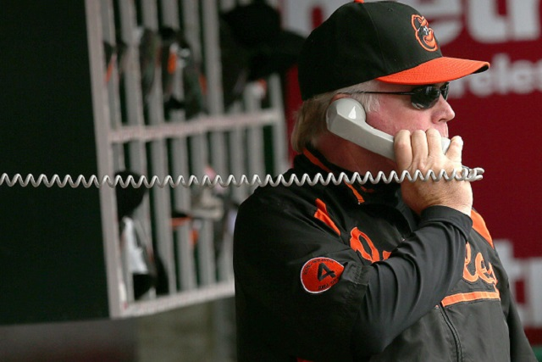
Background

Slide 4
Weighted Saves
Notes:
Chris: Using this pitch information

Slide 5
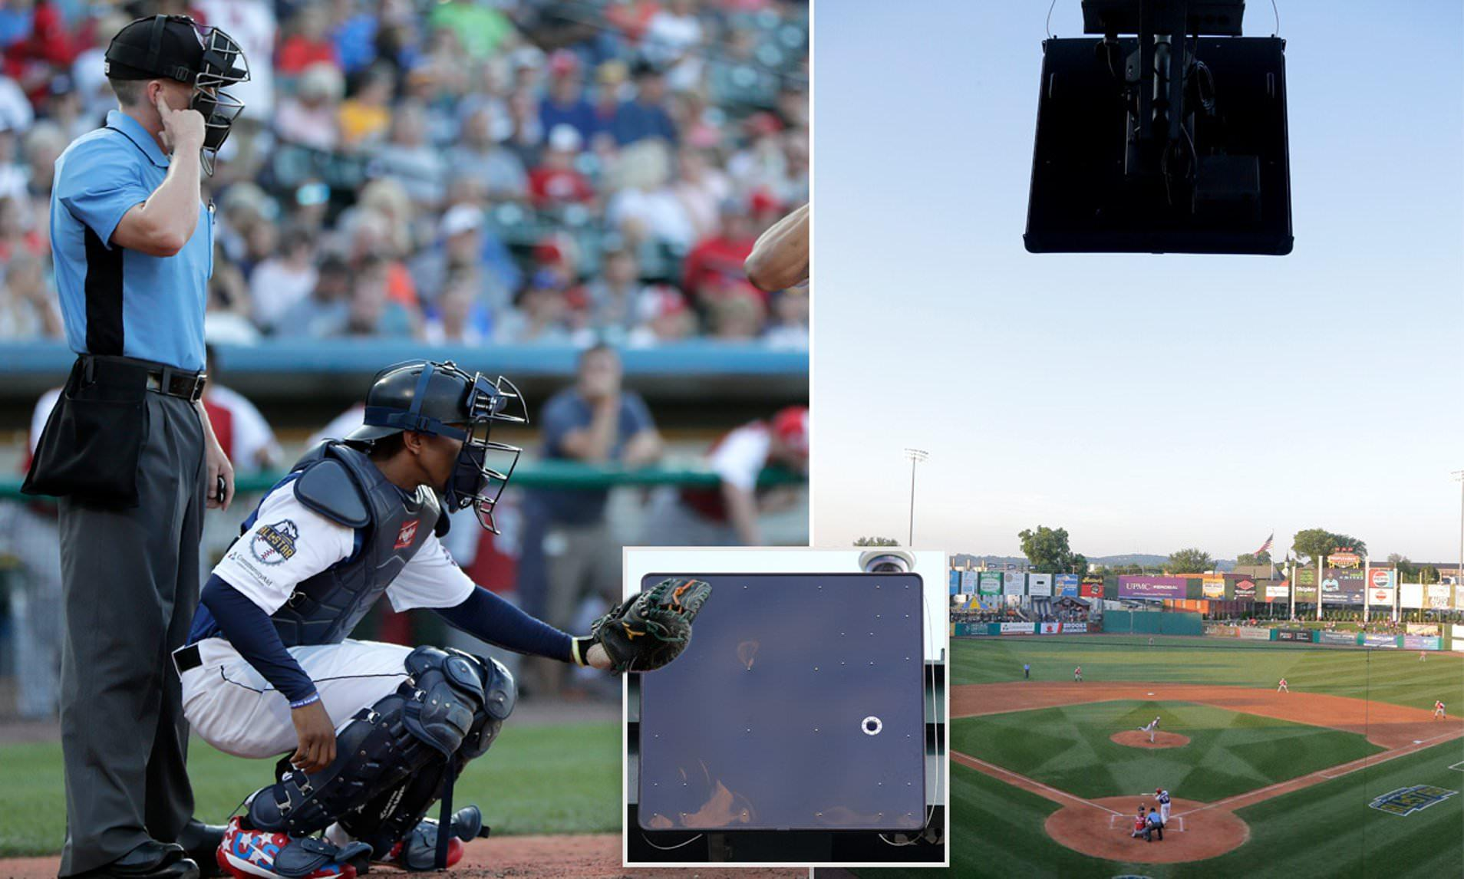
Robo-Umps
MLB testing Automatic Ball-Strike Systems in the minors
Plans to utilize ABS in MLB as soon as 2024
Notes:
Chris: It is very possible in the near future all ball and strike calls will be done by ABS

Slide 6
Motivation
The average number of missed calls in the 2438 regular and postseason MLB games in 2022 was 9.3
UmpScorecards analysis shows that missed calls may favor one team over another
How do missed calls affect game outcomes?
Notes:
Chris: According to UmpScorecard, ___

Slide 7
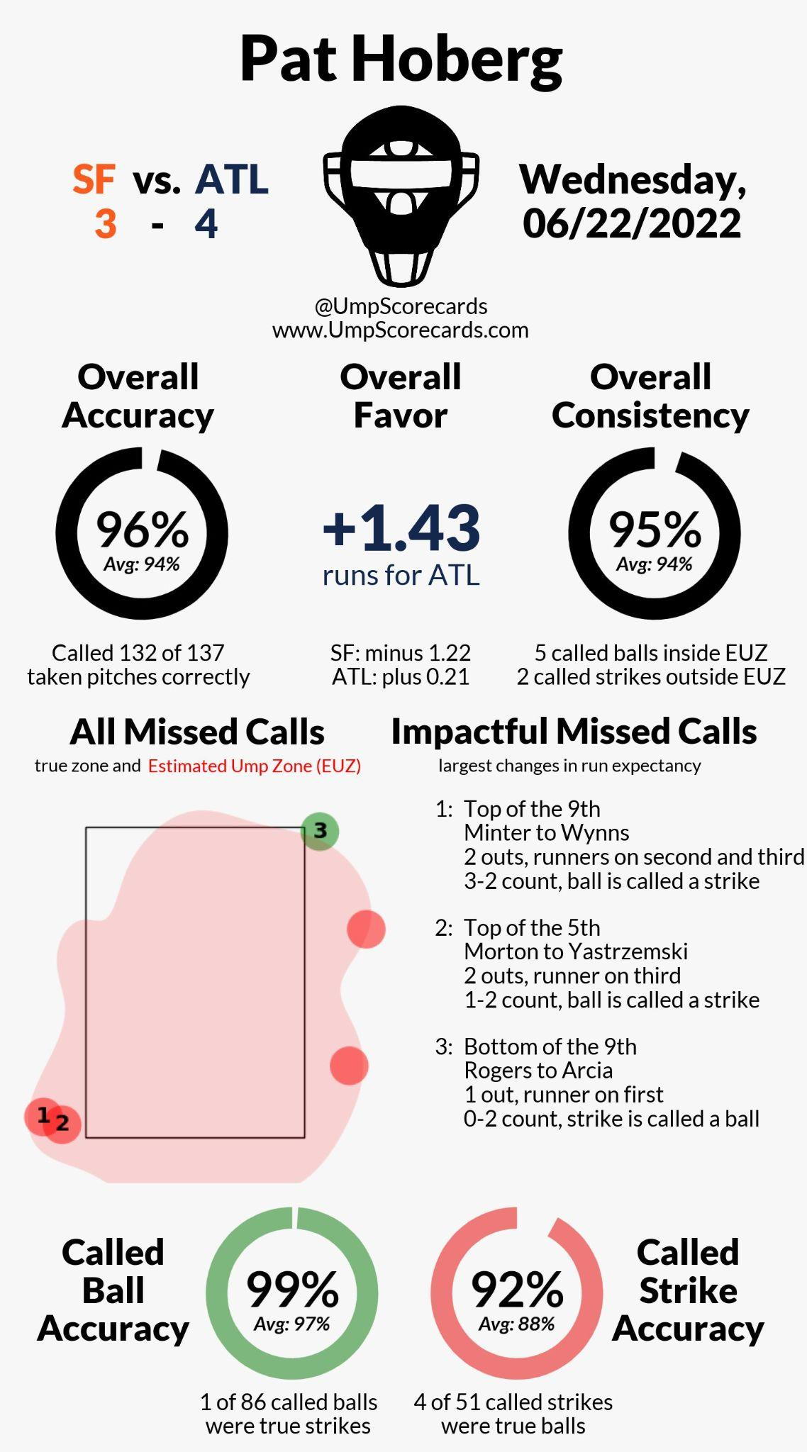
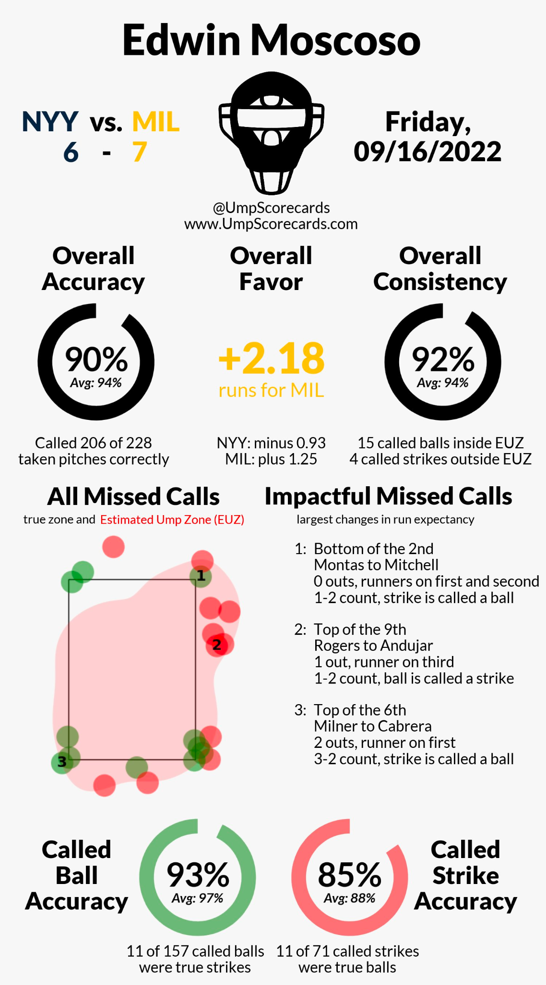
Games Analyzed
Notes:
Chris

Slide 8
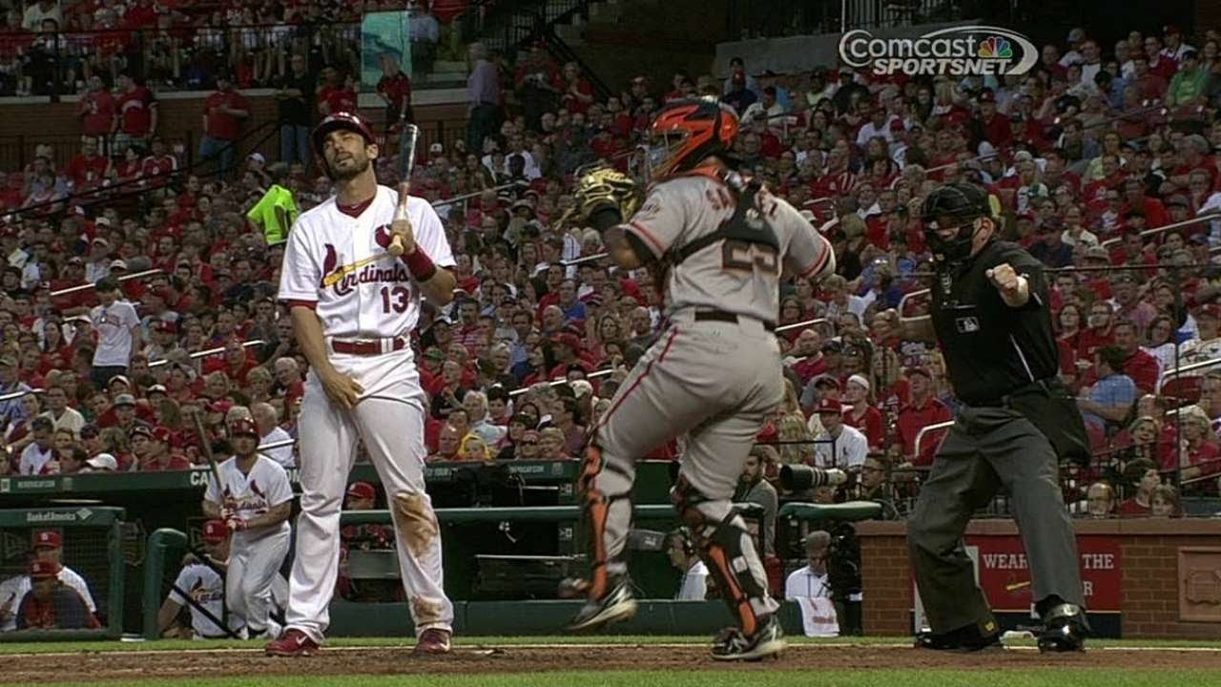
Finding Umpire Errors
Step 1: Identifying Missed Calls
Notes:
Richard

Slide 9
Methodology
Methodology
Use 17 inch home plate and 1.45 inches for ball radius
Considered a pitch a strike if any part of ball touches the zone
Used Python script to automate ball/strike decisions
Strike
Ball
Notes:
Richard

Slide 10
Results
Missed Call Results
Used one game from each group and analyzed all pitches in each game
Game | SFG @ ATL 6-22-22 | NYY @ MIL 9-16-22
Missed Calls (Ump Scorecards) | 5 | 22
Missed Calls (Our Method) | 8 | 24
Difference | +3 | +2
Notes:
Richard

Slide 11
Our Method vs. Ump Scorecards (FIX IMAGES)
Why did we get more mistakes?
UmpScorecards incorporates Hawk-Eye error into their model
Simulate 500 similar pitches
We used true Hawk-Eye data
Avoid introducing more error into system
Results in a more harsh stance on umpire decisions
Emulates Robo-Ump system
Notes:
Richard

Slide 12
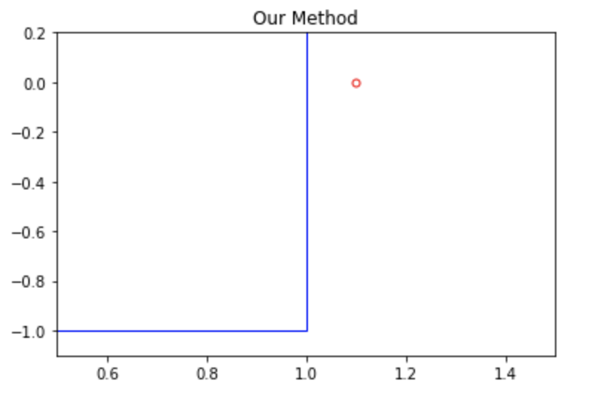
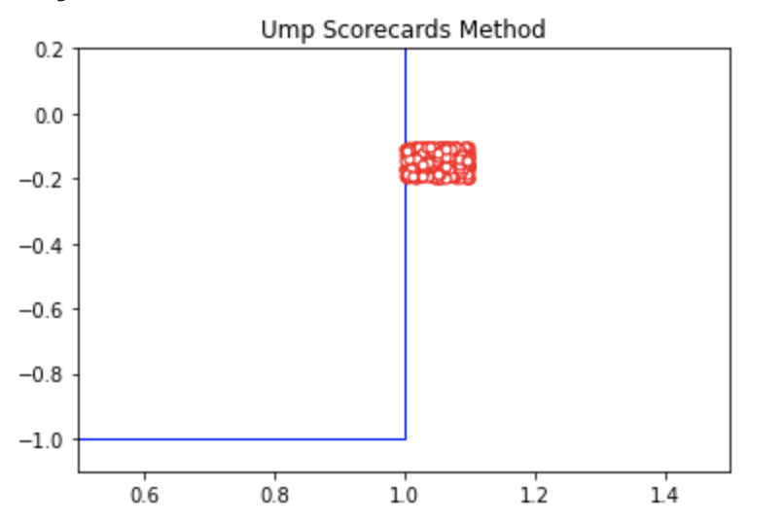
Visualizing the Difference
Suppose umpire calls this a strike
UmpScorecards says it’s an incorrect call if <10% of simulated pitches are strikes
Notes:
Richard

Slide 13
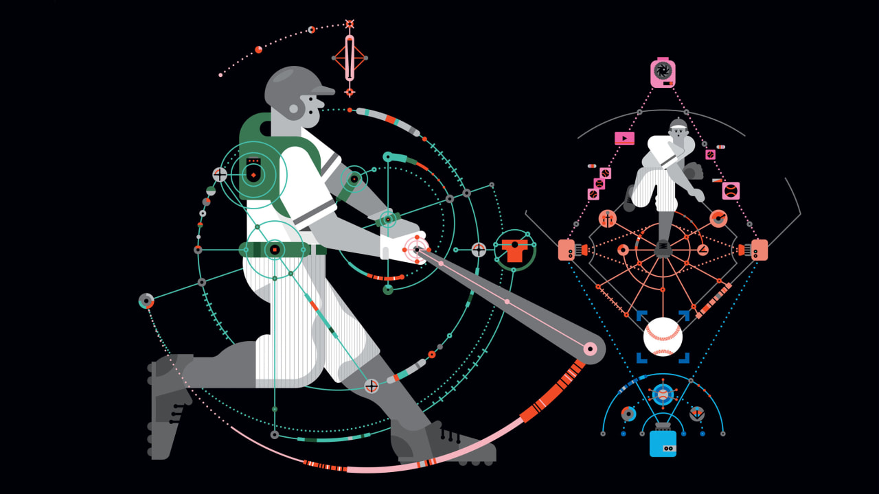
Handling Umpire Misses
Step 2: Simulating Games
Notes:
Brendan

Slide 14
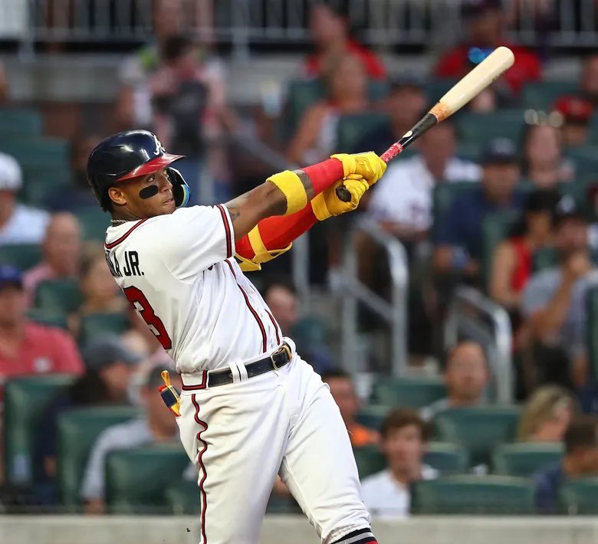
Player Specific Expected Runs
Unlike UmpScorecards, we use player specific data to compute the expected number of runs for a given situation
Simulating entire team lineup yields a better estimate of how costly an missed call is for a team versus using general run expectancy values
Notes:
Brendan

Slide 15
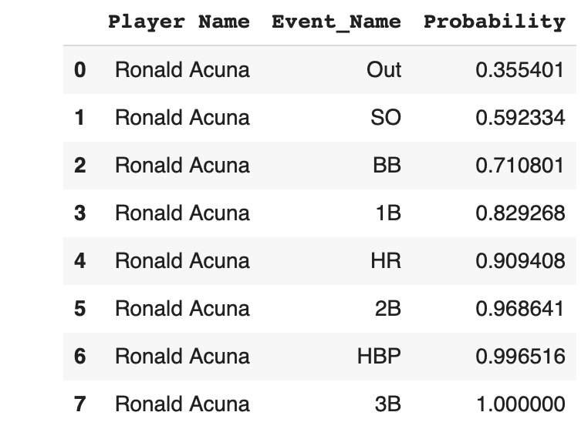
Monte Carlo Simulation
Calculate frequency of each event occurring over a season
Generate random number between 0 and 1 to select an event for a given at bat
Play out the rest of the inning from a given start state, recording number of runs scored
Compute expected runs (mean of 100,000 simulated half-innings)
Notes:
Brendan

Slide 16
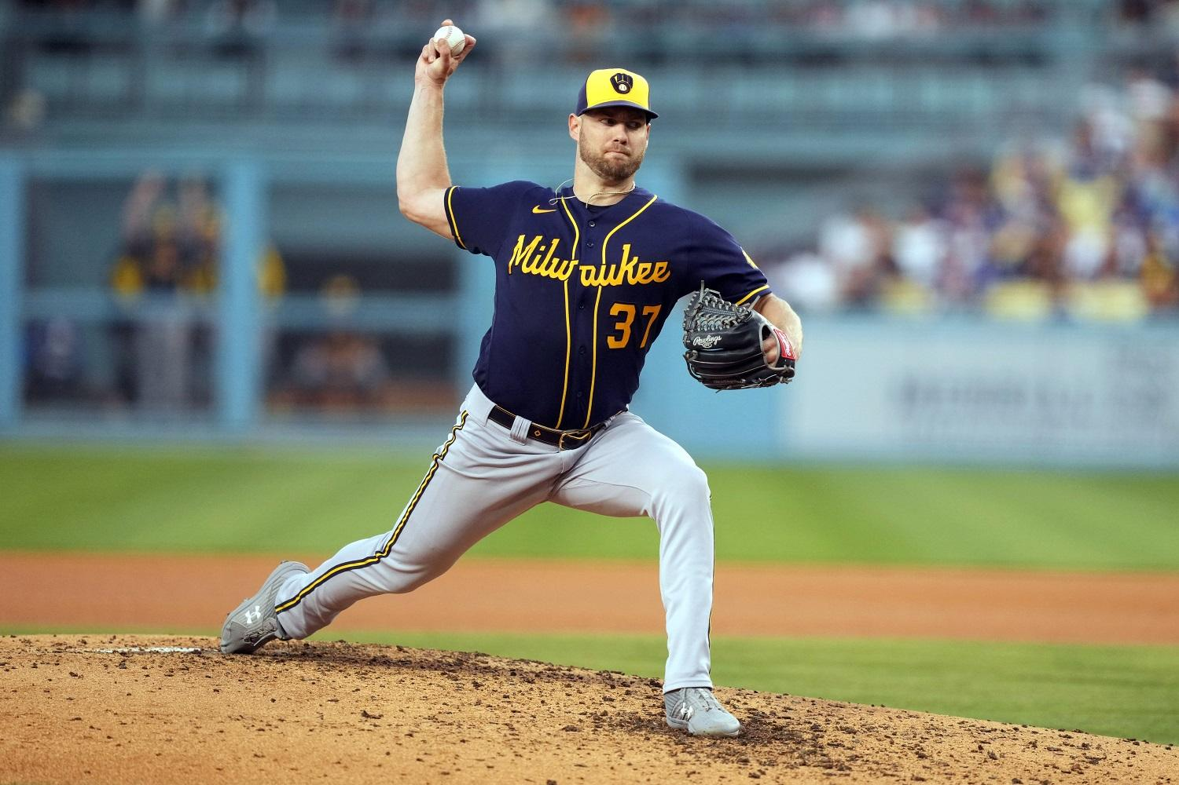
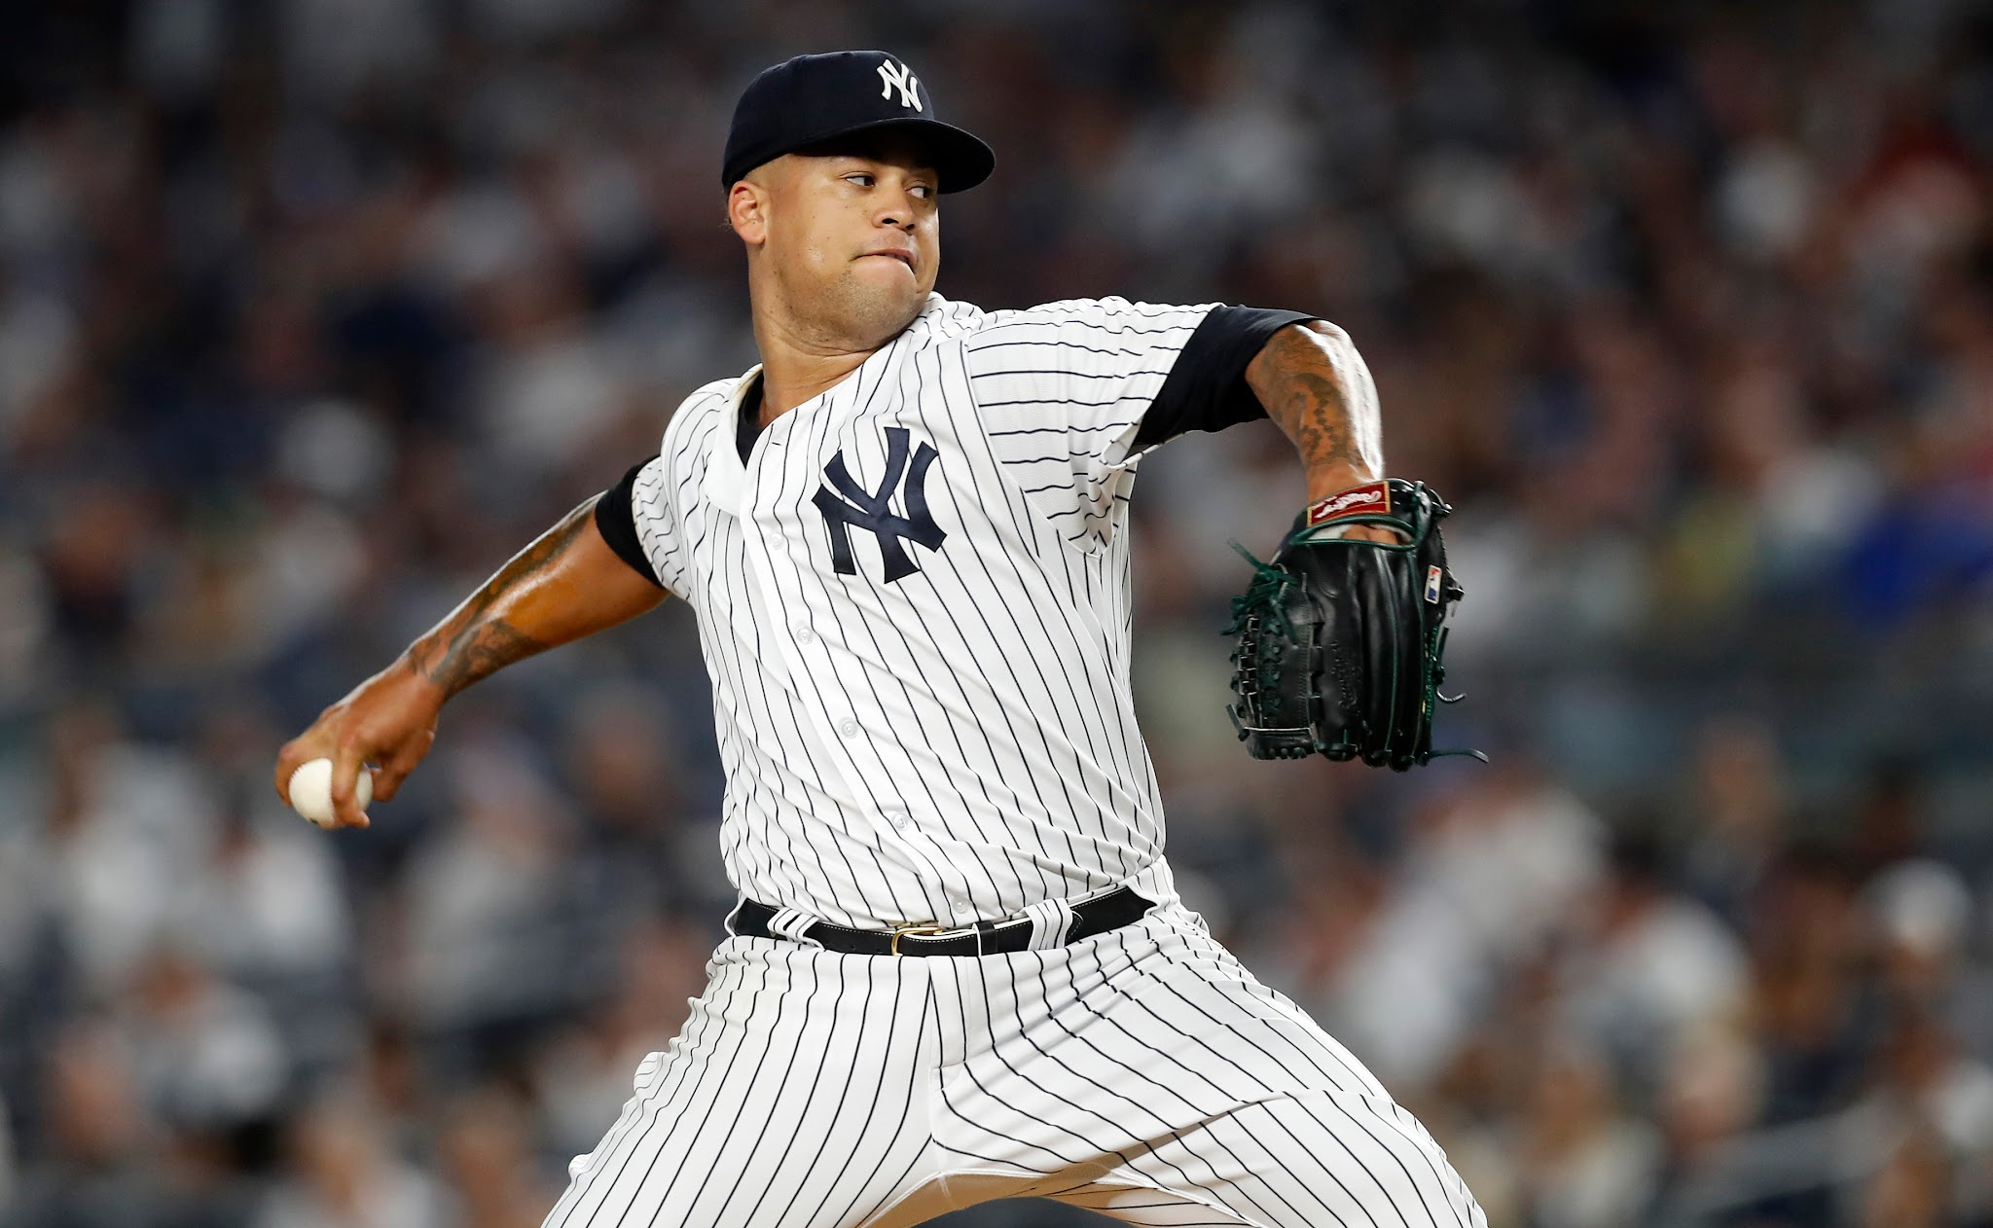
Additional Considerations
In order to improve expected run calculations, we used count-specific and situation-specific stats (RISP vs No RISP)
We adjusted our simulated run expectancies based on who was pitching at that point in the game
[Expected runs / (ERA+ / 100)]
Notes:
Brendan

Slide 17
Statistics Used in Simulation
We could not use 2022 player statistics
There was no feasible way to find situation-specific data for each player up to the analyzed game in the 2022 season
Baseball Savant does not collect data on player’s stats AFTER facing a particular count, rather it shows the outcomes when a player’s plate appearance ends at that exact count
Solution: Use 2021 stats as proxy (best available option)
Notes:
Brendan

Slide 18
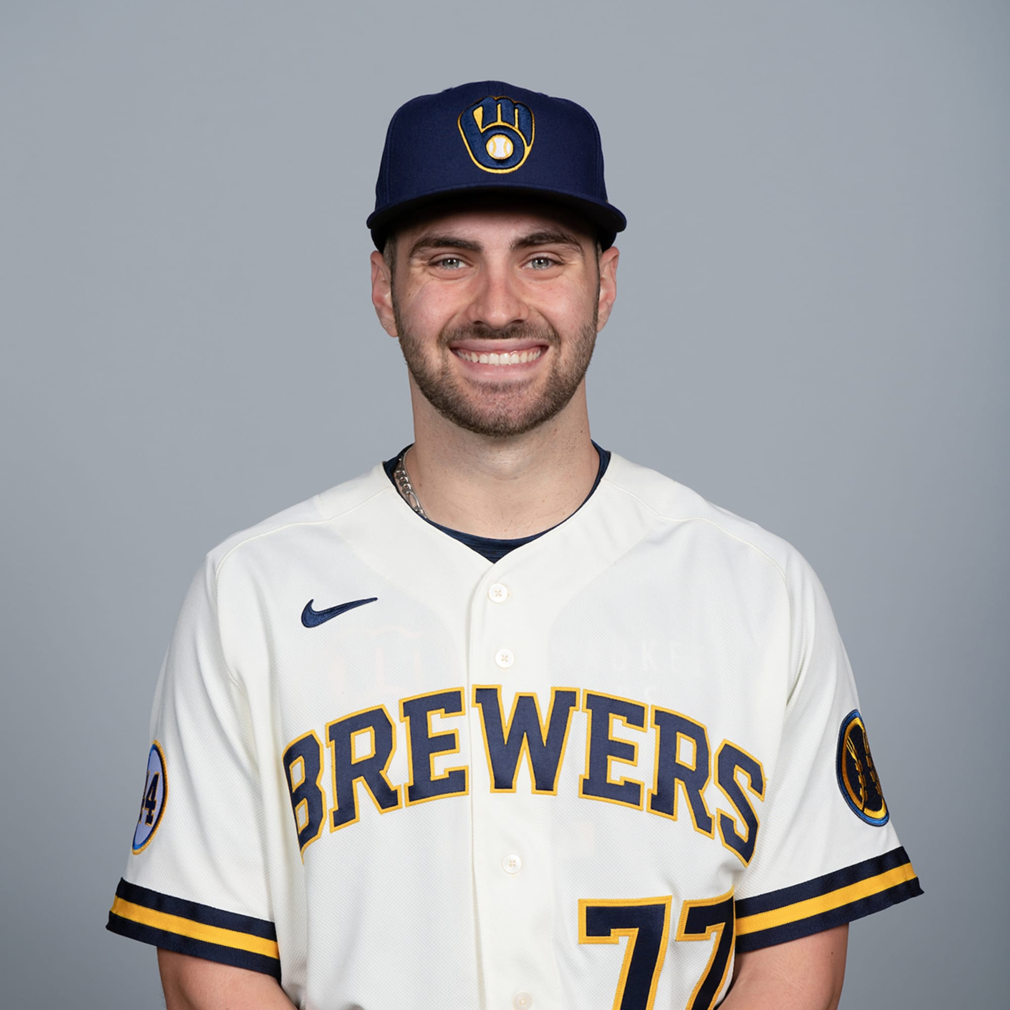
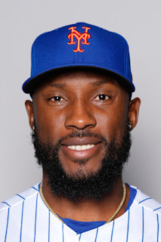
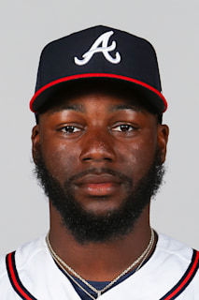
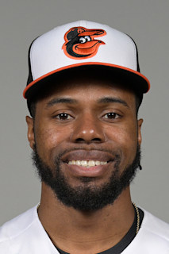
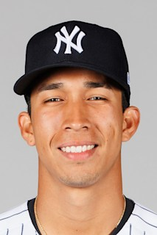
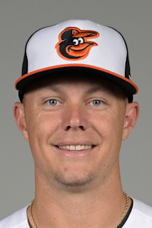
SimError Finding Methodology
ulation: Dealing with Rookies
Dealing with Rookies
2022 rookie players present a challenge
Solution: Use comparable players based on overall stats for rookies
〜
〜
〜
Oswaldo
Cabrera
Ryan
Mountcastle
Garrett
Mitchell
Starling
Marte
Michael Harris
Cedric
Mullins

Slide 19
Player Comps
Statistical Comparisons
Oswaldo Cabrera 2022: 111 wRC+; .247/.312/.429; 39% XBH
Ryan Mountcastle 2021: 111 wRC+; .255/.309/.487; 41% XBH
Garrett Mitchell 2022: 136 wRC+; .311/.373/.459; 26% XBH
Starling Marte 2021: 134 wRC+; .310/.383/.458; 29% XBH
Michael Harris 2022: 136 wRC+; .297/.339/.514; 40% XBH
Cedric Mullins 2021: 136 wRC+; .291/.360/.518; 41% XBH

Slide 20
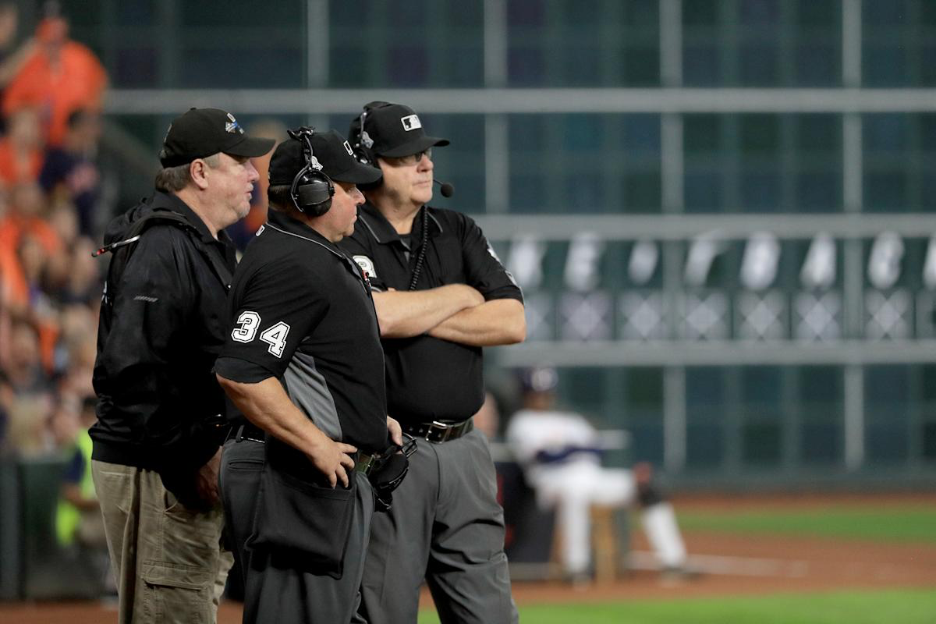
Handling Umpire Misses
Step 3: Case Analysis
Notes:
Ben

Slide 21
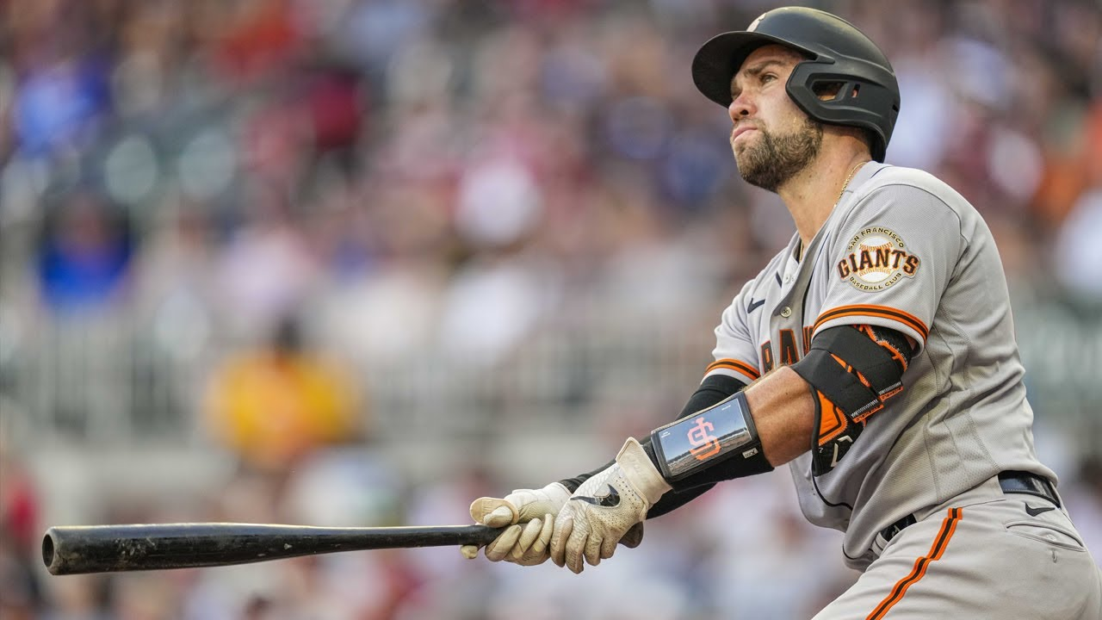
Simple Cases
If hitter should have struck out to end inning: end inning
If hitter should have walked, but did not → simulate from next batter with runner on first
If hitter should have struck out, but did not → simulate from next batter adding an out
Austyn Wynns got a strike called on him on a 3-2 count when it should have been a ball, so we award him a walk
Notes:
Ben

Slide 22
Simulation Process
One Mistake Innings
Step 1: Change the count based on missed call
Step 2: Simulate remainder of plate appearance, using count-specific hitting stats
Step 3: Simulate rest of inning if necessary using situation (RISP) specific hitting stats
Step 4: Aggregate change in runs scored (Lower limit of change = 0)
[(Expected run value after mistake) - (actual run value after mistake)] + actual runs scored before mistake = expected half-inning run total
Notes:
Ben

Slide 23
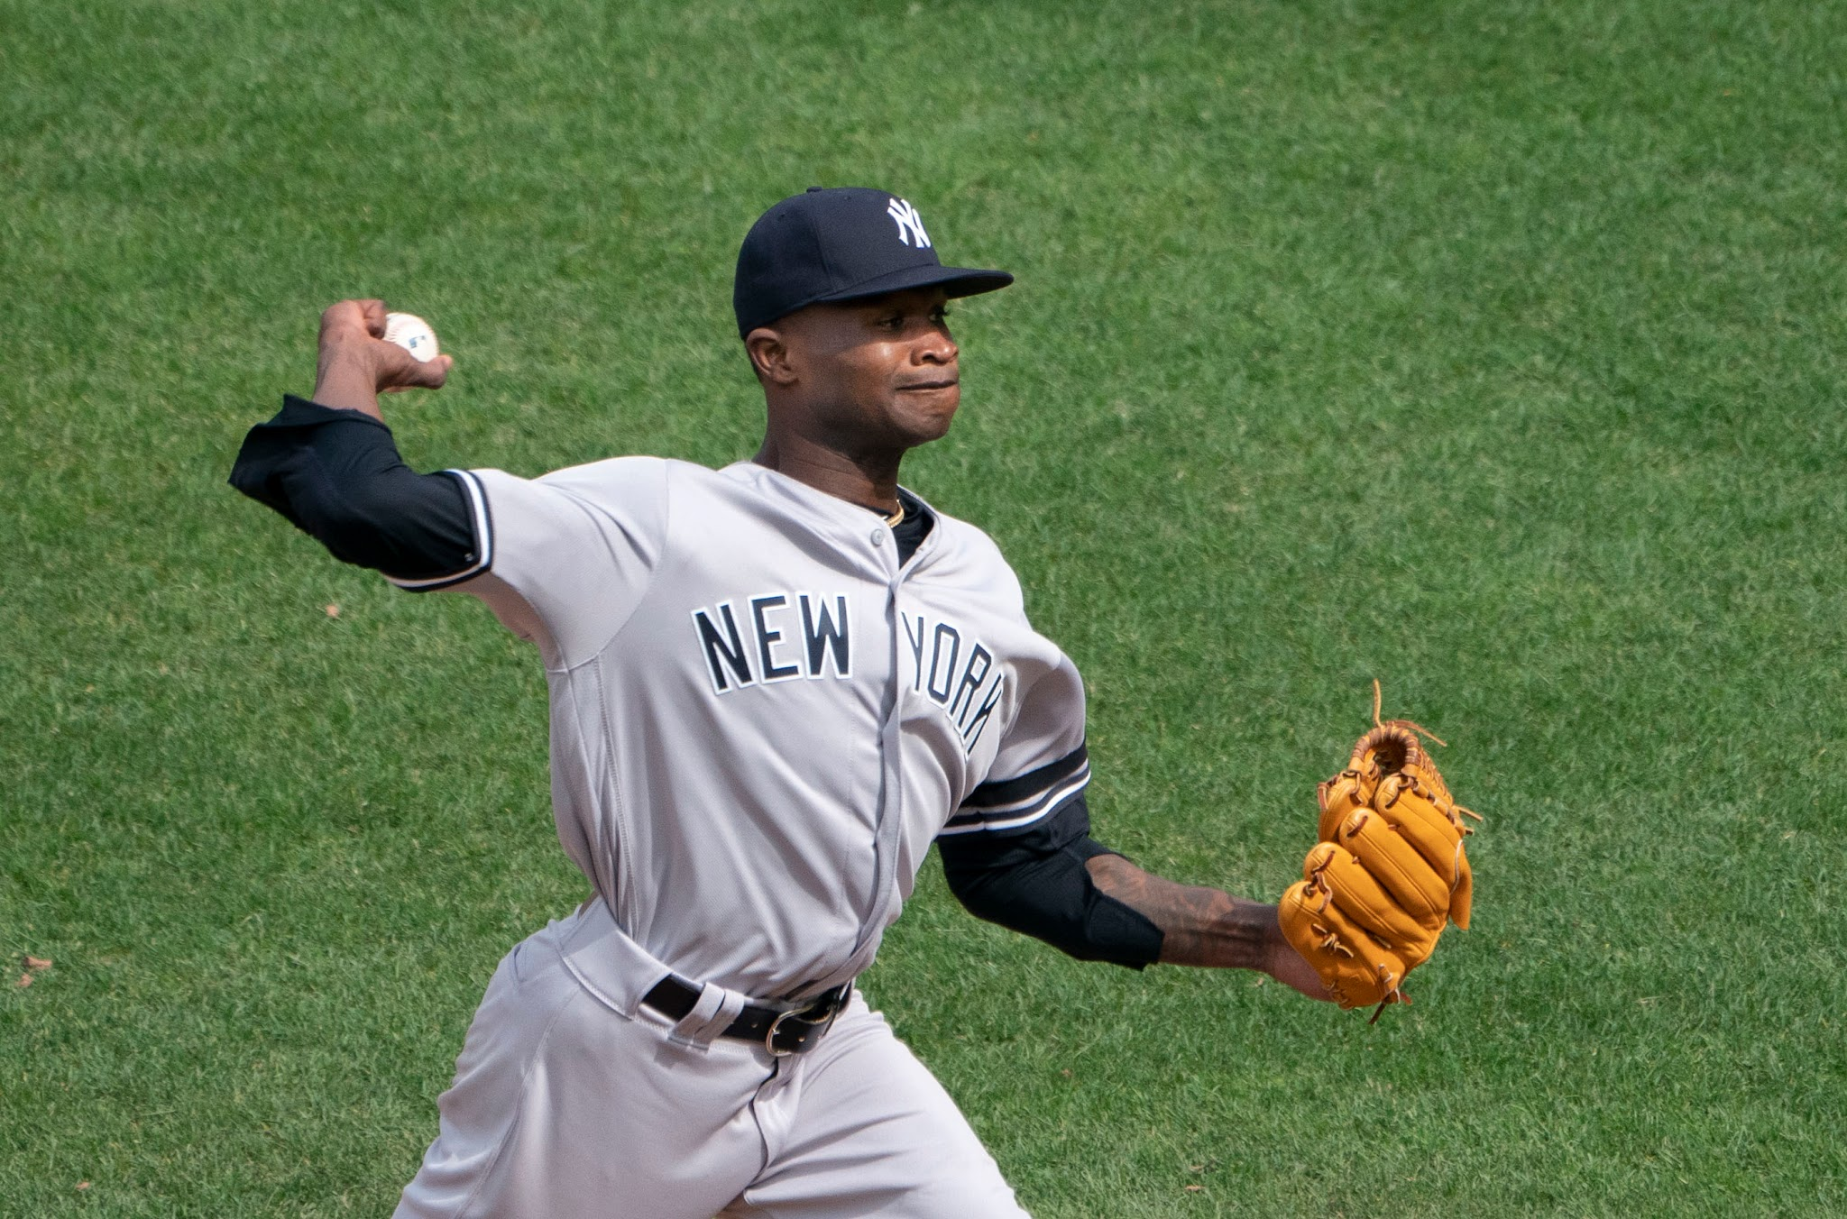
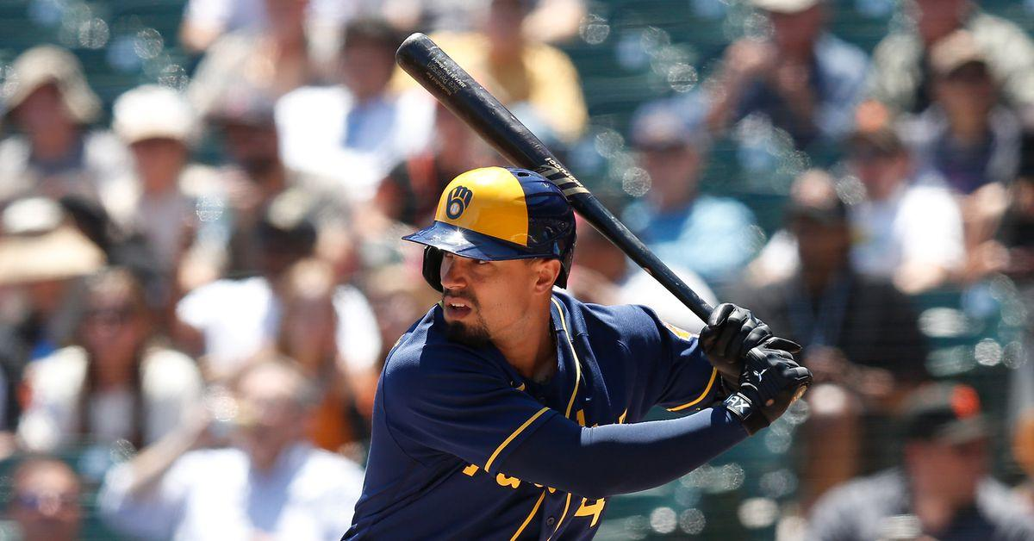
Example - Squandered Opportunity
Situation: 5th inning, 0-0 count, 2 outs
Domingo German throws ball to Jace Peterson, count goes to 1-0
Pitch should be a strike, so our simulation hurts Brewers by moving count to 0-1
Since the Brewers had a more favorable situation in real life, yet scored 0 runs, we award 0 runs
Notes:
Ben

Slide 24
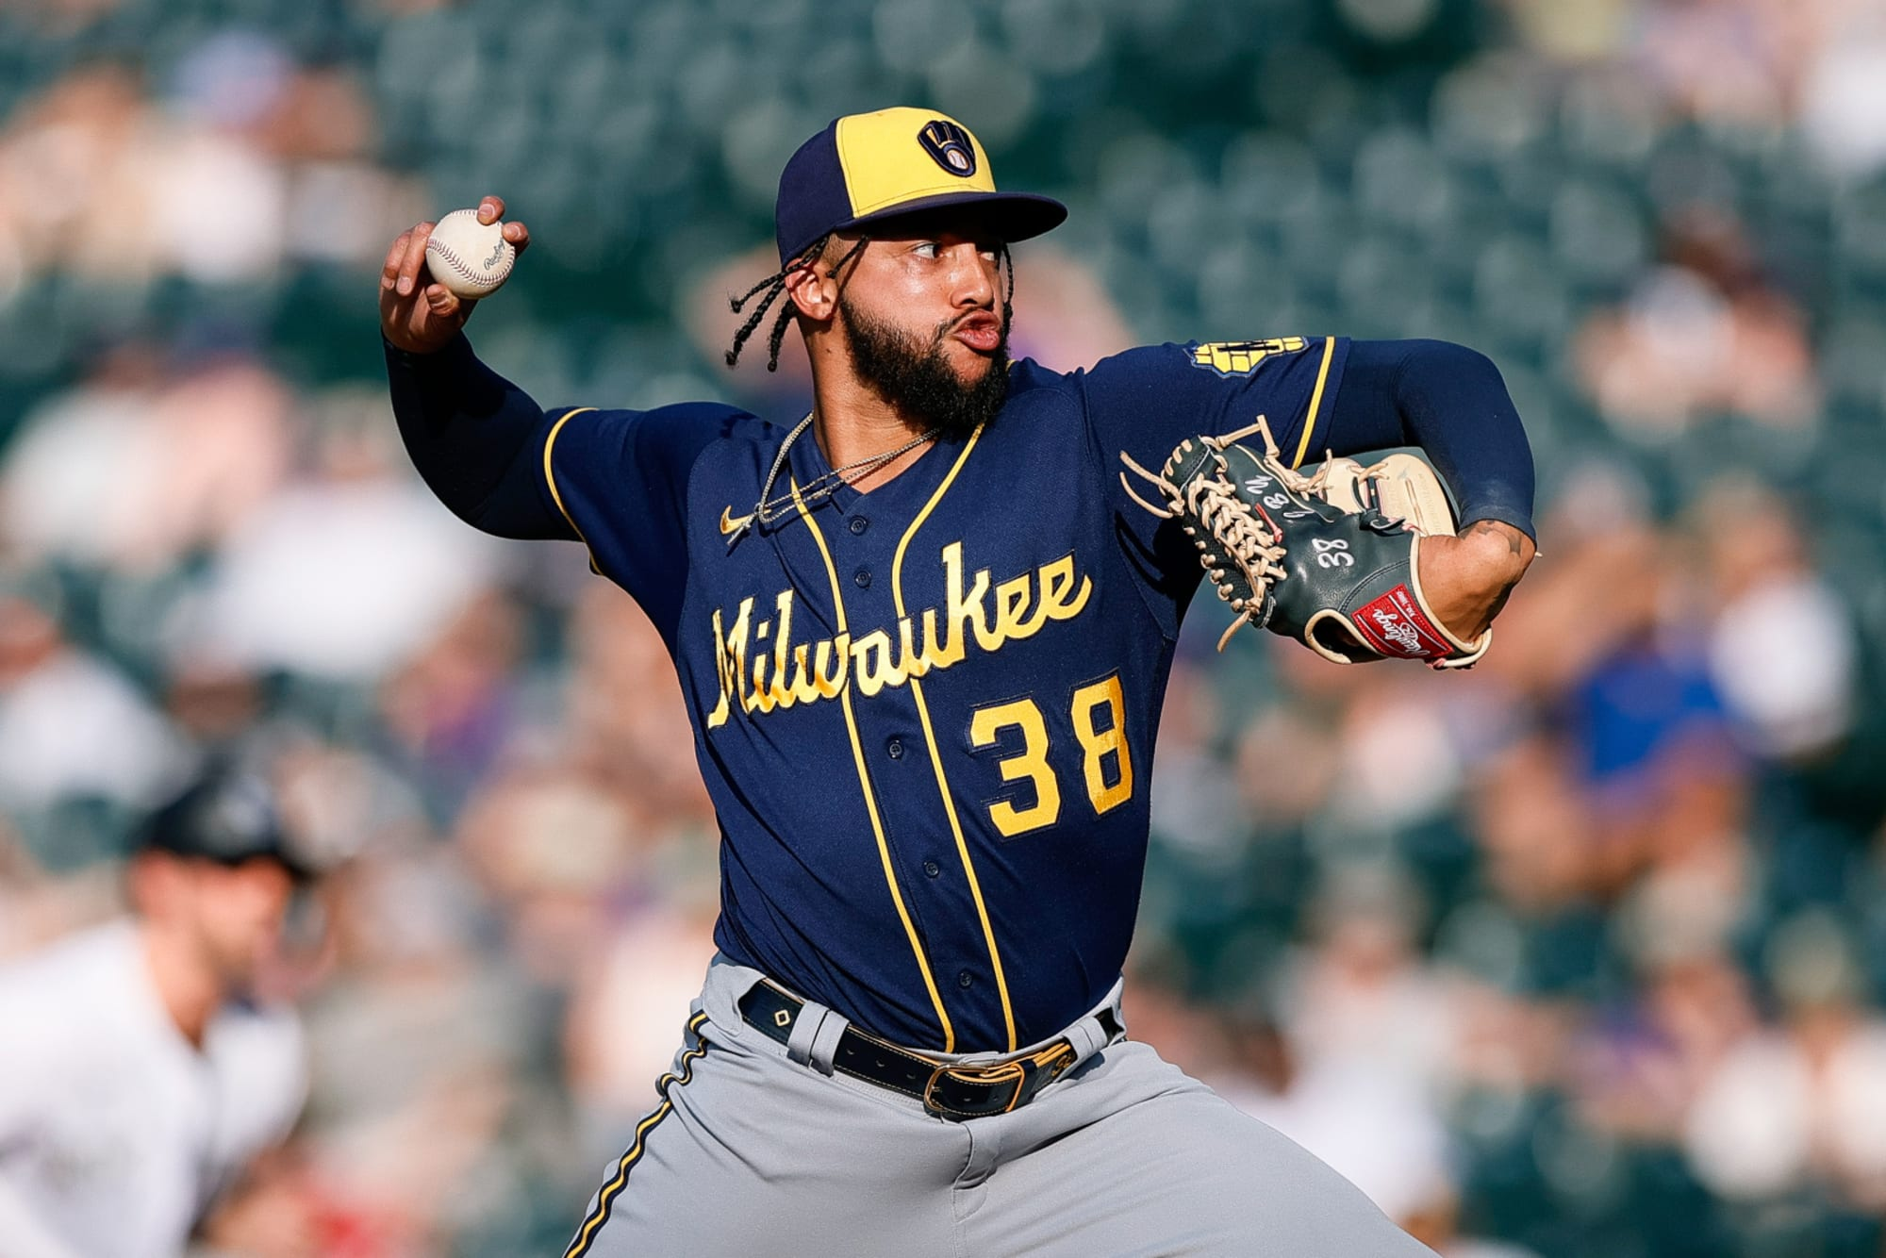
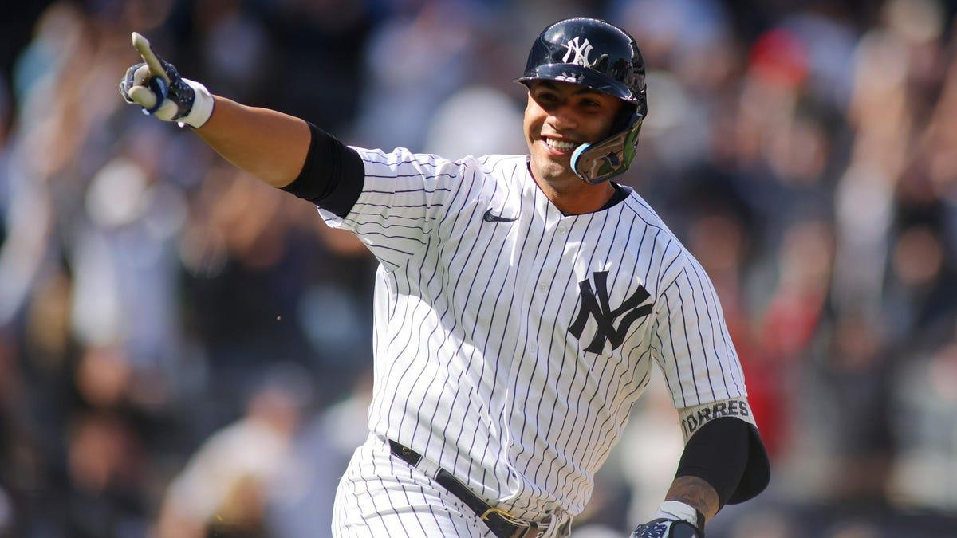
Example - Yankees Take Advantage
Situation: 8th inning, 0-0 count, 2 outs
Devin Williams throws strike to Gleyber Torres, count goes to 0-1
Pitch should be a ball, so our simulation benefits Yankees by moving count to 1-0
Our simulation finds the Yankees now have 0.1 expected runs, and as they scored 0 in the game, so we add 0.1 to 0 to get a new run total of 0.1 runs (before factoring in pitcher ability)
Notes:
Ben

Slide 25
2 Beneficial Mistakes in One Inning
Start of half inning
Mistake 1
Mistake 2
End of half inning
p(M2|M1)
y
x
x = Expected runs after mistake 1
y = Expected runs after mistake 2
p(M2|M1) = Probability of reaching the state at which mistake 2 occurs given
the corrected call from mistake 1
Expected run total of half inning = ((1 - p(M2|M1)) * x) + (p(M2|M1) * y) + previous runs
Notes:
Ben

Slide 26
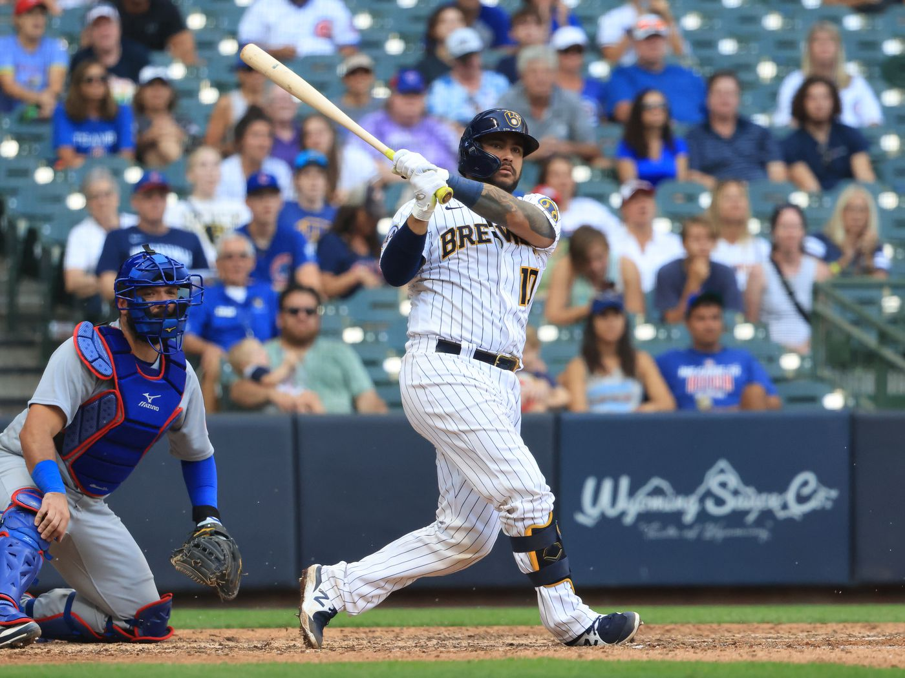
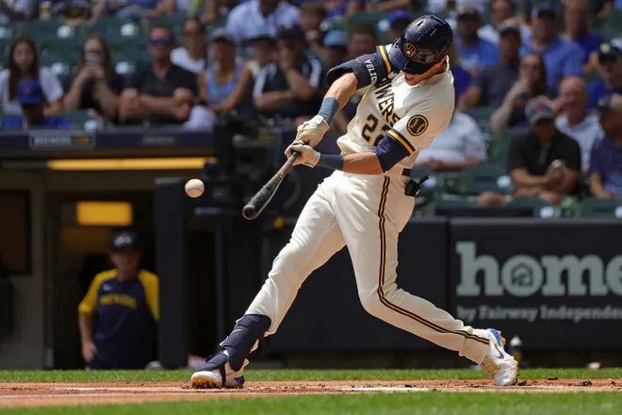
Example - Brewers Bottom 2nd
Omar Narvaez at bat: A strike is mistakenly called a ball to make it 1-1
Christian Yelich at bat: A strike is mistakenly called a ball to make it 1-0
In total, the Brewers scored 3 runs, all of which came after the mistakes
Simulation
0.83 expected runs after Narvaez
1.08 expected runs after Yelich
((1.08 * 0.0625 * 0.157) + (0.83 * 1- (0.0625 * 0.157)))/1.22 = 0.68 expected runs in the inning
1.22 adjusts for above average pitcher
Notes:
Ben

Slide 27
3 Relevant Mistakes in One Inning
Only occurs once, Yankees batting in the top of the 2nd. They scored 2 runs in the inning:
Aaron Judge 0-1 count that should have been 1-0
Umpire call harmed Judge → expected runs after corrected call 1.08 before pitcher adjustment
Oswaldo Cabrera 3-1 count that should have been 2-2
Umpire call benefited Cabrera → expected runs after corrected call = 0.27 before pitcher adjustment
Isiah Kiner-Falefa 0-1 count that should have been 1-0
Umpire call harmed Kiner-Falefa → expected runs after corrected call = 0.33 before pitcher adjustment
Notes:
Cabrera and Falefa’s mistakes cancel each other out, since one harmed the team and one hurt the team to similar degrees in successive plate appearances
Ben

Slide 28
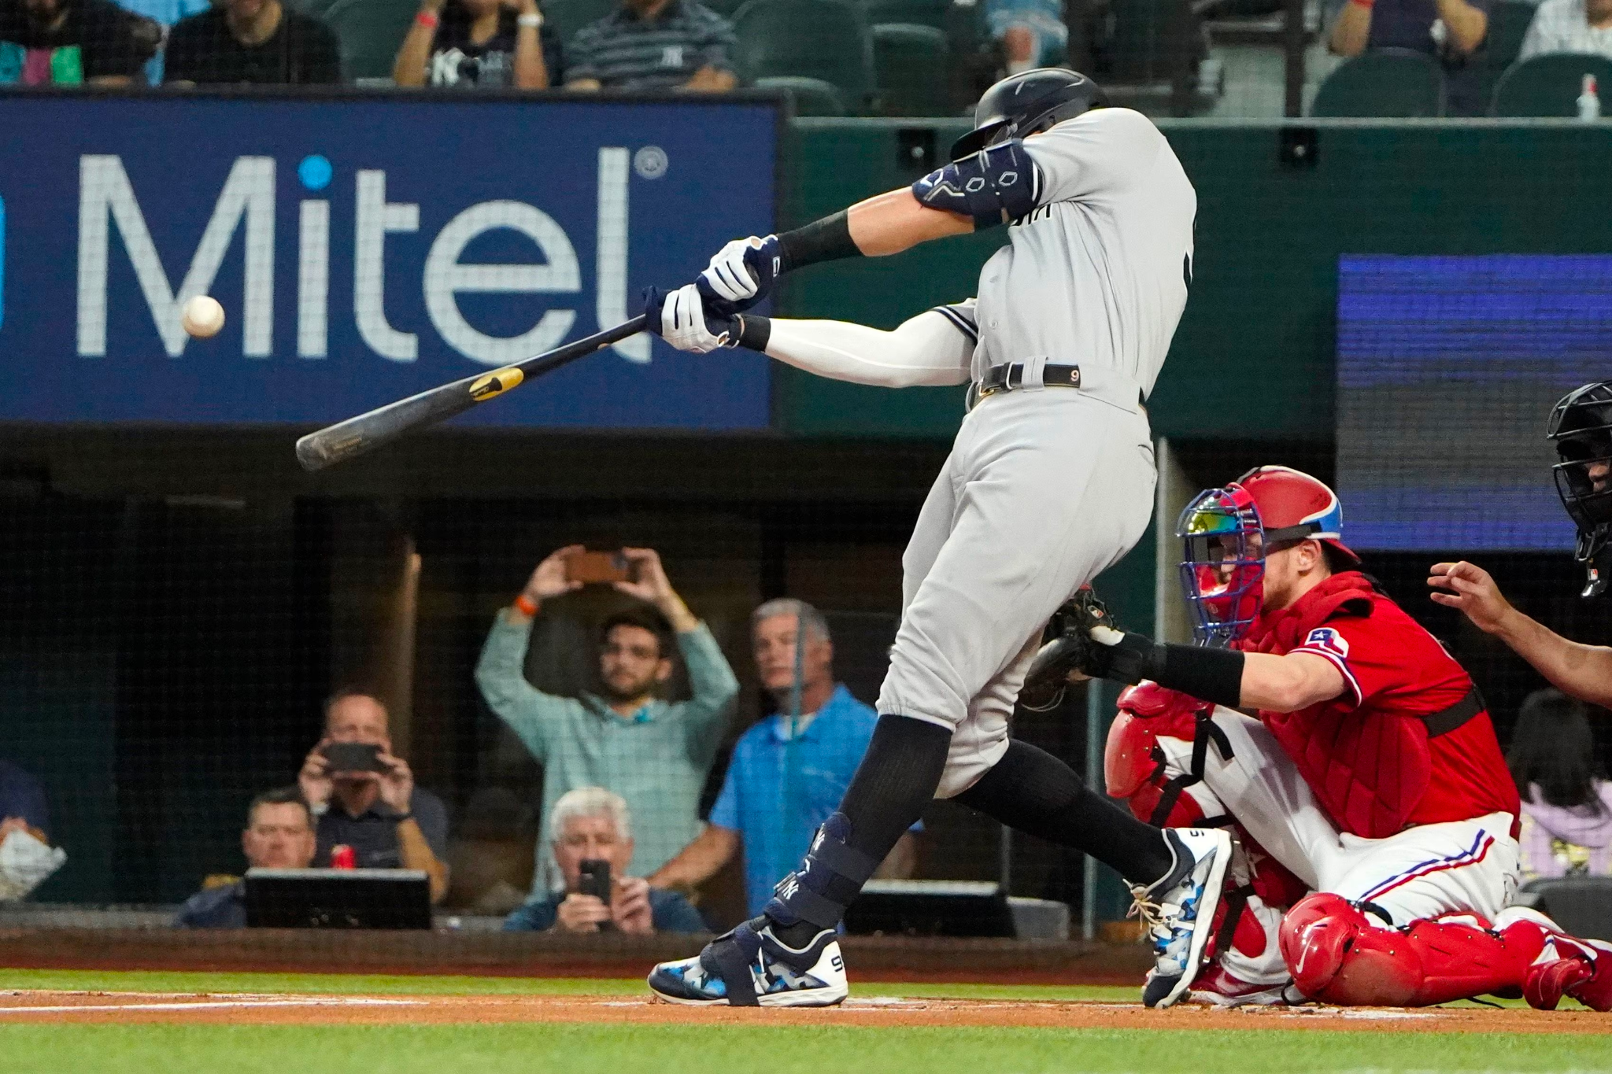
3 Relevant Mistakes in One Inning
How we handled it:
Judge’s expected runs is less than the actual runs and the call was harmful, so we used the actual run result following his plate appearance (2 runs)
Cabrera and Kiner-Falefa’s mistakes are consecutive and the expected run impacts of the mistakes are within 0.02 runs of each other, so they cancel each other out
Therefore, our run total for this inning was the actual run total of 2 runs
Notes:
Cabrera and Falefa’s mistakes cancel each other out, since one harmed the team and one hurt the team to similar degrees in successive plate appearances
Ben

Slide 29
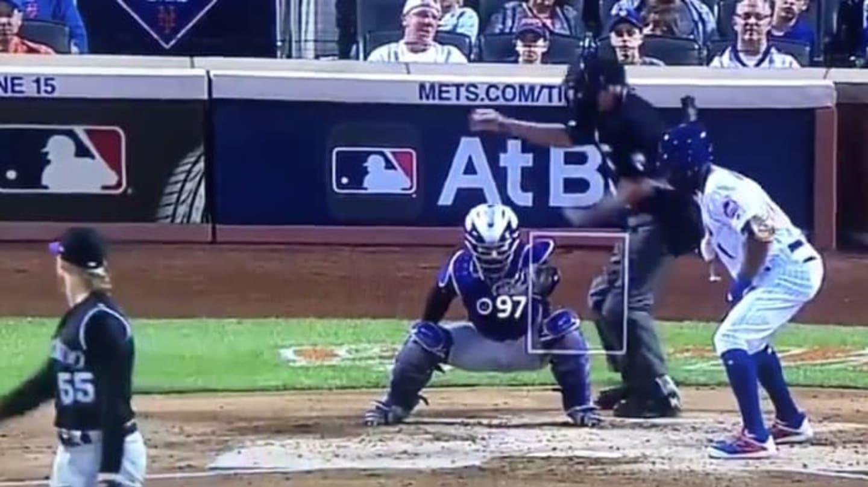
Background
Step 4: Simulation Results
Notes:
Chris

Slide 30
Results
We recomputed the score of each half inning in which an umpire mistake occurred
In order to compute an overall score, we summed the runs scored during innings in which there were no mistakes with our expected run total for each inning where a missed call was present
This process is repeated for each team and then the new final scores are compared to determine the winner after correcting for umpire mistakes
Notes:
Chris

Slide 31
Giants vs. Braves
Original Score:
Braves 4, Giants 3
Corrected Score:
Braves 4.6, Giants 4.7
Notes:
Chris 8 missed calls

Slide 32
Yankees vs. Brewers
Original Score:
Brewers 7, Yankees 6
Corrected Score:
Brewers 2.8, Yankees 7.7
Notes:
Chris 24 missed calls

Slide 33
Conclusion
Our method accounts for hitter performance in specific game situations for each team instead of calculating general run expectancy
We adjust the expected runs to account for pitchers ability, unlike UmpScorecards which assumes average pitching
UmpScorecards grades the performance of the ump, our method is focused on a potential altered game outcome
Notes:
Chris Including whether runners are in scoring position or not, and the count. By factoring ERA+ into our run expectancy after running the SIM. By grading the ump’s performance instead of predicting the corrected final score of the game, UmpScorecard doesn’t take into account what actually happened in the game after the mistake so a mistake that prolonged an inning that should have ended. And in which multiple runs were scored after the mistake, would still be treated as the difference in expected runs rather than realizing the inning should end and none of the runs should have happened

Slide 34
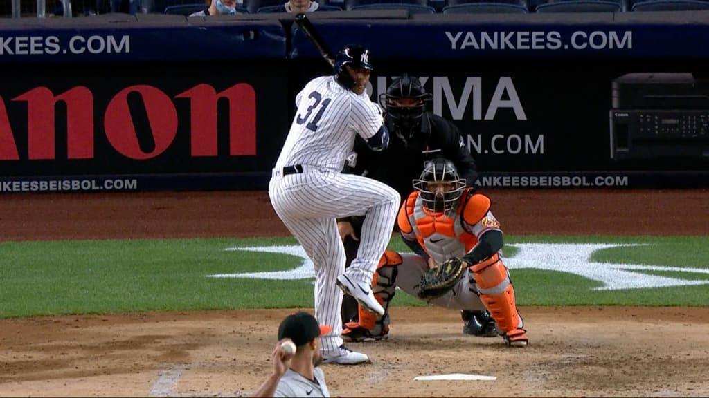
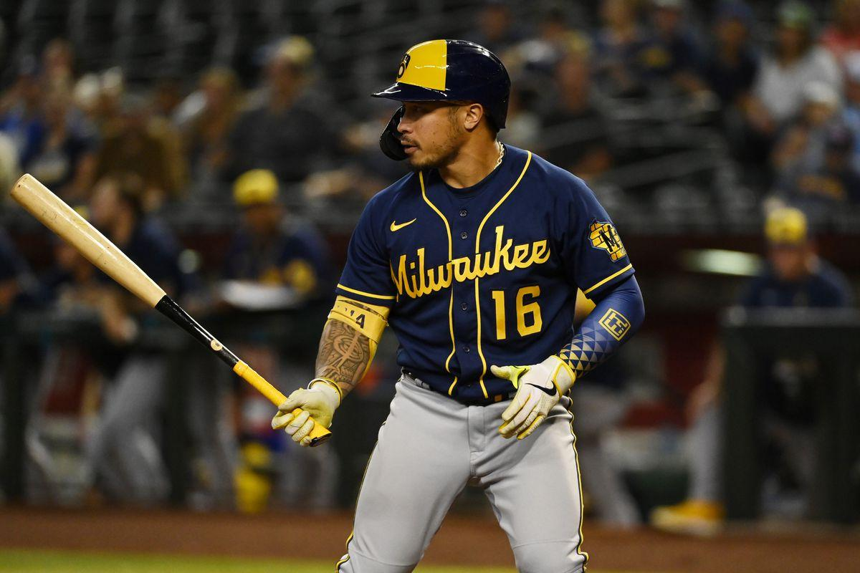
Other Ideas Considered
Simulating the game from the start
Simulating game from the first error onward
Using run expectancy difference (similar to UmpScorecards)
Good for grading umpires, bad for rewriting game outcome
Notes:
Richard

Slide 35
Sources of Error
Used 2021 data, not necessarily indicative of 2022 performance
Quantifying two mistakes in one inning is difficult because second mistake may not happen if first one didn’t happen
Corrected calls may change batting order in future innings, which was not accounted for
Player comparisons may not be perfect (especially count specific stats)
Didn’t use specific counts for pitchers
Matchups were not considered
Count specific stats sometimes have small sample size
Notes:
Richard

Slide 36

References
FanGraphs
Baseball Savant
Baseball Reference
UmpScorecards
Numbers used in simulation:
Percentage of runners that score from first on doubles ~40% and percentage of runners that score from second on single ~60% via Beyond The Box Score
Percentage of balls in play that turn into double plays (in double play situations) ~8.87% via Baseball Savant

Slide 37
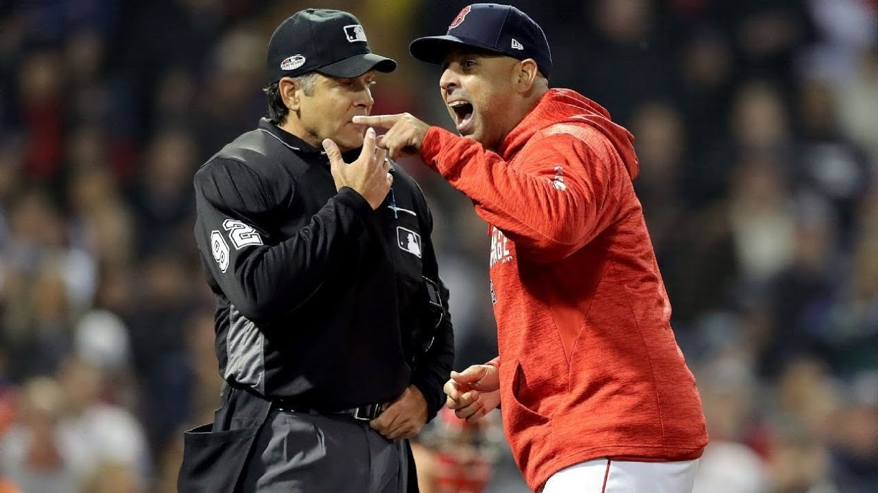
Questions?

